Slide 1
An Adaptive Framework for RDF Stream Processing

Slide 2
Contents
Introduction
RDF Stream && C-SPARQL
From C-SPARQL to SPARQL
Framework
Experiments and Evaluations

Slide 3
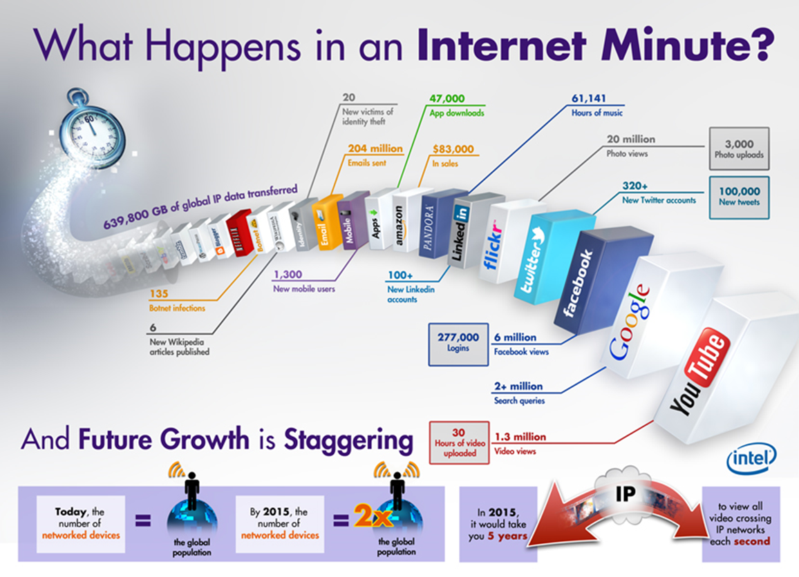
Introduction
RDF stream, as a new type of dataset, can model real-time and continuous information in a wide range of applications, e.g. environmental monitoring and smart cities.

Slide 4

Introduction
For RDF stream processing (RSP), there are a few works by extending SPARQL to
support queries over RDF streams such as C-SPARQL, EP-SPARQL, CQELS, etc.
These works are all only for processing RDF graphs which change infrequently, but not for RDF streams.
Sesame
Jena
……
SPARQL query engines
gStoreD
RDF-3X
gStore
TriAD
4

Slide 5
Introduction
How to design a framework which can apply the current SPARQL query engines to process RDF streams?

Slide 6
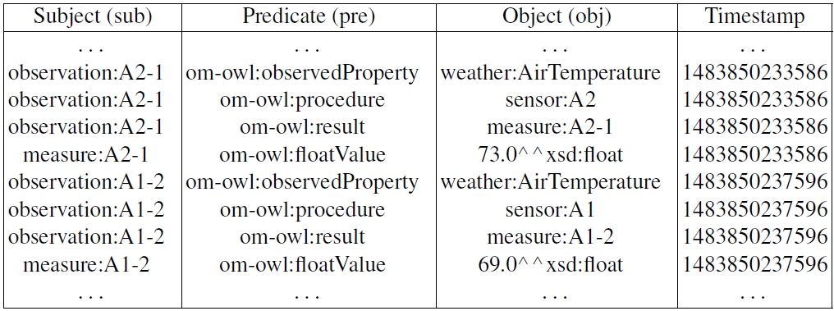
RDF Stream && C-SPARQL
RDF:
An RDF triple is formed by a triple (s, p, o).
An RDF graph is a finite set of RDF triples.
RDF Stream
An RDF stream S is defined as an (possibly infinite) ordered sequence of pairs which are quadruples, and each pair is made of an RDF triple (si, pi, oi) and a timestamp Γi(ΓI is an integer) as follows:
Now, we give an example of RDF stream：

Slide 7
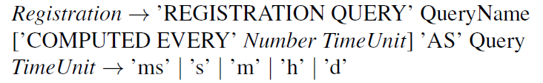
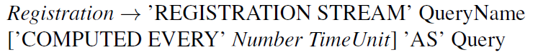
RDF Stream && C-SPARQL
C-SPARQL (Continuous SPARQL)
C-SPARQL extends SPARQL by adding new operators, namely, registration and windows, to support processing RDF streams.
Query registration
Stream registration

Slide 8
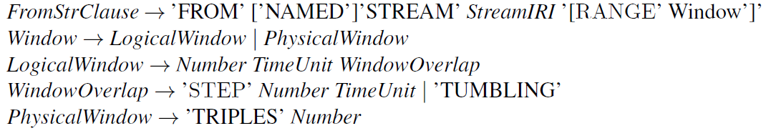
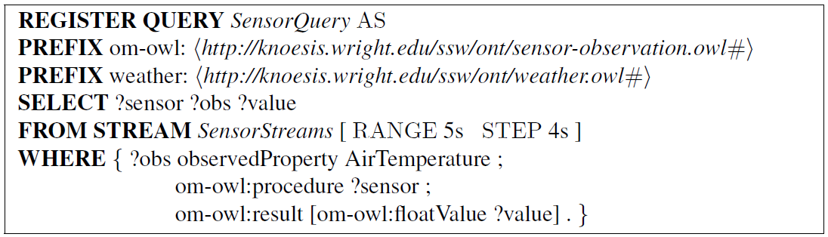
RDF Stream && C-SPARQL
Window
Now, we give an example of C-SPARQL:

Slide 9
From C-SPARQL to SPARQL
Thinking:
If we want to exploit the SPARQL query engines to process RDF streams, we must reduce the evaluation of C-SPARQL query to the evaluation of SPARQL query equivalently.
Now we give the formal definition of both C-SPARQL and window, and then prove them to ensure the soundness and completeness of our reduction.

Slide 10
From C-SPARQL to SPARQL
Formally, a C-SPARQL query Q can be taken as a 5-tuple of the form:
Q = [Req, S, w, s, ρ(Q)]
where
Req: the registration;
S: the RDF stream registered;
w: RANGE, i.e., the window size;
s: STEP, i.e., the updating time of windows;
ρ(Q): a SPARQL query.

Slide 11
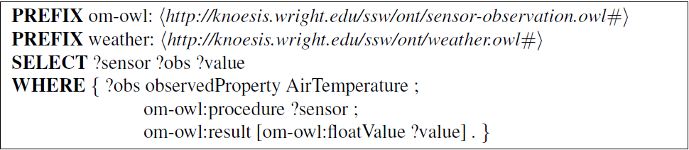
From C-SPARQL to SPARQL
Now, we give an example of C-SPARQL：
Req(Q) = REGISTER QUERY SensorQuery AS；
S(Q) = SensorStreams;；
w(Q) = 5s；
s(Q) = 4s；
ρ(Q) is a SPARQL query as follows ：

Slide 12
From C-SPARQL to SPARQL
The difference from C-SPARQL to SPARQL：
The registration of C-SPARQL query ensures the continuous recall of C-SPARQL query periodically. However, SPARQL query does not support such a continuous mechanism for recalling query. So we need to design an extra trigger to provide the mechanism.
C-SPARQL can support RDF streams but SPARQL cannot due to the timestamp of tuples of RDF streams. We note that the timestamp of quadruples in a window of an RDF stream can be ignored. In this sense, SPARQL can characterize the core pattern of C-SPARQL in a window of an RDF stream.
C-SPARQL query consists of RDF streams which are to be processed. Indeed, C-SPARQL query processes periodical windows of RDF streams and windows can be stored in the present RDF dataset which can be evaluated by SPARQL queries.

Slide 13
From C-SPARQL to SPARQL
Based on the discussions above, window is an important notion in transforming C-SPARQL to SPARQL.
Let k be a natural number. A k-th (logical) window, denoted by W(S, w, s, t, k), for
an RDF stream S, a window size (RANGE) w, an updating time of windows (STEP)
s, and an initial time t are a collection of quadruples defined as follows:
Intuitively, a window is a snapshot of a stream. Accordingly, when k = 0, it is the
initial window.
For instance, the initial window W(Ssensor, 5s, 4s, 1483850232556, 0) (i.e., the initial time t = 1483850232556) is shown in Table 3 and the first window W(Ssensor, 5s, 4s, 1483850232556, 1) is shown in Table 4:

Slide 14
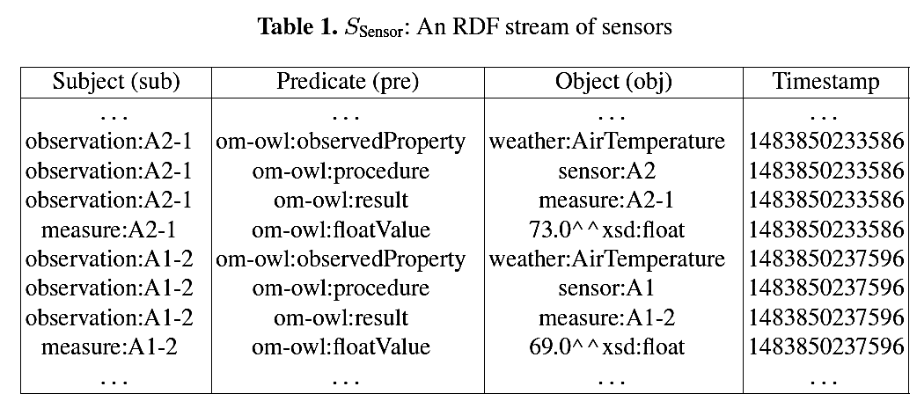
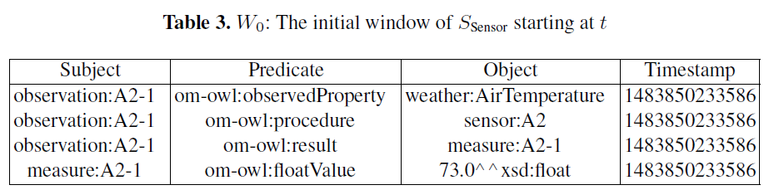
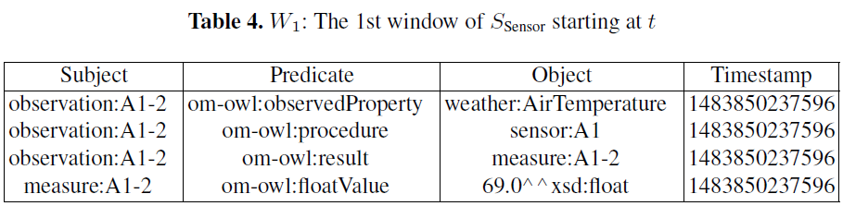
From C-SPARQL to SPARQL

Slide 15
From C-SPARQL to SPARQL
Lemma1. Let Q be a C-SPARQL query. For any RDF stream S and any initial time
t, if S is registered in Q then for any natural number k,
[[Q]]S(t,k) = [[Q]]Wk ,
where Wk = W(S, w, s, t, k).
Lemma2. Let Q be a C-SPARQL query. For any RDF stream S and any initial time
t, if S is registered in Q then for any natural number k,
[[Q]]Wk = [[ρ(Q)]]G(t, k),
Where Wk = W(S, w, s, t, k) and G(t, k) = G(Wk).
Theorem 1. Let Q be a C-SPARQL query. For any RDF stream S and any initial time t, if S is registered in Q then for any k = 0, 1, 2, …,
[[Q]]S(t, k) = [[ρ(Q)]]G(t, k),
where G(t, k) = G(Wk).

Slide 16
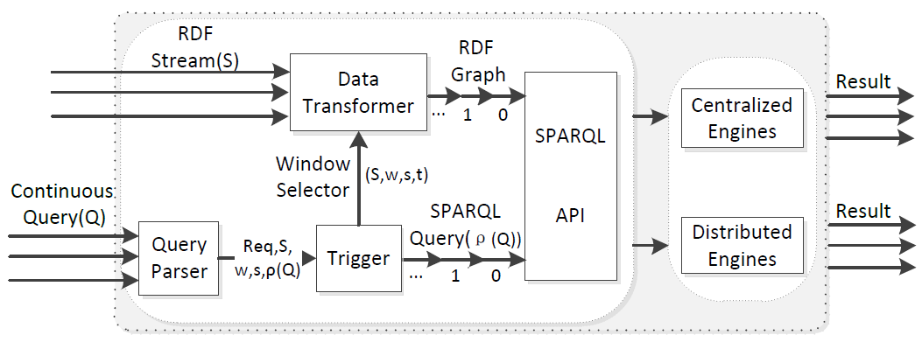
Framework
Query Parser: C-SPARQL SPARQL;
Trigger: Call SPARQL queries (ρ(Q)) and produce window selector (S, w, s, t) periodically;
Data transformer: RDF stream RDF graphs;
SPARQL API: Process RDF graphs, and so far our framework has support three centralized engines, Jena, RDF-3X and gStore, and two distributed engines, gStoreD and TriAD.

Slide 17
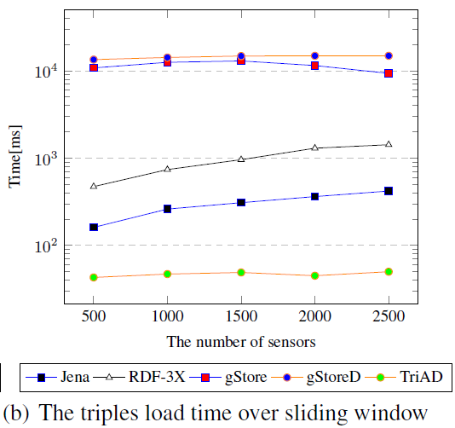
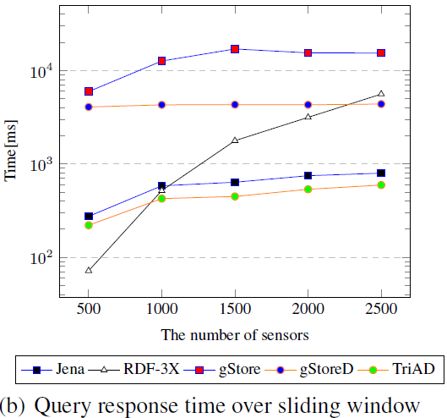
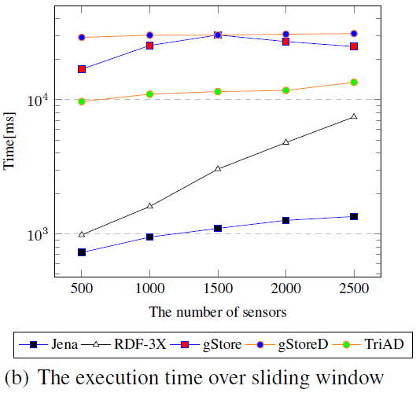
Experiments and Evaluations
The influence factor about SPARQL query engines processing RDF streams.
The capacity of loading data;
The capacity of processing data.

Slide 18
Conclusion
Formalize a C-SPARQL query to ensure the soundness and completeness of our reduction from C-SPARQL queries to SPARQL.
B
C
A
Implement the framework and we can evaluate the different SPARQL query engines in processing RDF streams in a unified platform. We also exploit the YABench to evaluate the results.
Develop an adaptive framework for processing RDF stream, and support distributed SPARQL query engines to process large-scale RDF streams.

